Slide 1

COLLEGE OF SCIENCE AND TECHNOLOGY NATIONAL POLICE COLLEGE SCHOOL OF ICT DEPARTMENT OF COMPUTER SCIENCE MODULE OF WEB SECURITY
Firewall in web security
By MUNYEMBABAZI Olivier
220018984

Slide 2
What is a firewall
In web security, a firewall is a network security device/software that monitors and filters incoming and outgoing network traffic based on an organization’s previously established security policies.
A web application firewall (WAF) protects web applications from a variety of application layer attacks such as cross-site scripting (XSS), SQL injection, and cookie poisoning, among others.
Examples: Cloudflare WAF, Reblaze, AWS WAF, nginx, etc.

Slide 3
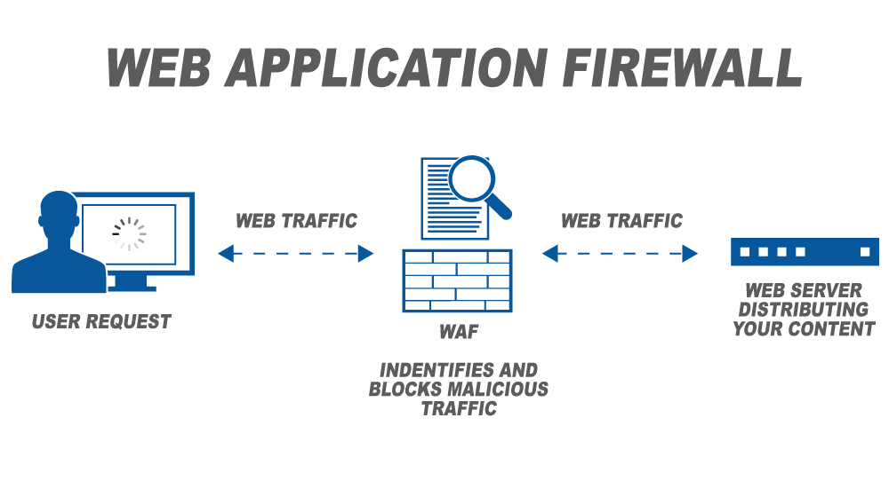
Web application firewall

Slide 4
Types of web application Firewall
a cloud-based WAF: is a managed by a service provider that offers the WAF as a security-as-a-service.
example : MS Azure Web Application Firewall
software-based WAF: is a virtual appliance that is hosted either locally or in the application cloud environment .
example: securi website firewall
hardware-based WAF: is deployed through a hardware appliance, installed locally within the network close to the web application servers.
example: WAPPLES

Slide 5
Web Application Firewall configuration models
Whitelisting tells the WAF to only allow in traffic that has been pre-approved and meets specified criteria.
Blacklisting is configured to block known vulnerabilities and malicious signatures but allow all other traffic.
Hybrid is configured to incorporate both whitelisting and blacklisting methods for the specific need of the web application

Slide 6
Thank you!

